Slide 1
Customer Churn Prediction Capstone Project Kalaivani.K.G DSBA – Dec ‘20

Slide 2
Business Problem Understanding
1
Problem, Objective, Scope and Constraints

Slide 3
BUSINESS PROBLEM & OBJECTIVE
DTH provider facing heavy competition resulting in customer churn
Loss of customers = Loss of Revenue
Huge initial cost /customer & fixed content fee to broadcasters impacts profits
Customer acquisition cost = 5 X customer retention cost
Increasing customer retention by 5% increases profits from 25-95%
Customer churn impacts topline and bottomline revenue
OBJECTIVE
Predict customer churn so that segmented offers can be given as part of a
retention campaign

Slide 4
SCOPE AND CONSTRAINTS
Scope
Best performing model for churn prediction
Key insights and recommendations from EDA and model
Constraints
Focus of prior retention campaigns not known – cashbacks, coupons
Campaign Budget not known

Slide 5
Data & Modelling
2
Modelling approach, model performance, best model

Slide 6
KEY INFORMATION ABOUT DATA
Shape
Dataset contains 11260 rows and 19 columns
5 float
2 integer
12 object
Nulls
- 4361 total nulls in all predictor fields
- 2.28% of all predictor fields
Duplicates
0 duplicates in the dataset
Outliers
- 2658 outliers in numeric continuous columns
- Constitutes 1.4% of all predictor fields
Data clean up
-10 attributes required clean-up
- Special characters such as #, &, +, $, @ present
- Different representations of same category present. E.g., Male and M, Female and F
Target variable
-Churn = 1 (Churned customer)
Churn = 0 (Active customer)
-16.8% churned customers in dataset
- Class imbalance

Slide 7
Modelling Approach
Model evaluation criteria – Good fit, Interpretable, F1score, Precision, Recall for 1s
Visual inspection
Observe rows & columns, understand attributes, datatypes, nulls
Perform data cleaning
Statistical description
8 Algorithms selected
Classifier versions from SKLearn and Statsmodel
EDA
Perform univariate and bivariate analysis
Anova and Chi-squared test (YoY revenue growth, Coupons for payment)
Correlations between variables
Base model with default hyperparameters
for benchmarking
Performance improvement
Data changed for different trials
Hyperparameters tuned (Grid Search)
Regularization
Ensembles
Data Preparation
Remove unwanted variables (Account ID)
Missing value treatment
Outlier treatment
Variable transformation (Encoding)
Best model within each algorithm selected based on evaluation criteria
Pre- processing
High VIF variables removed (Cashback, Service Score, Clusters, User Count)
Train-test split in 70:30 ratio
Scaling
Model performance comparison across best models of all algorithms
Modelling
Try out different algorithms (8) & evaluate performance on train and test
Benchmark base model performance
Tune hyper parameters and change data
Select best model based on evaluation metrics
Decide best model

Slide 8
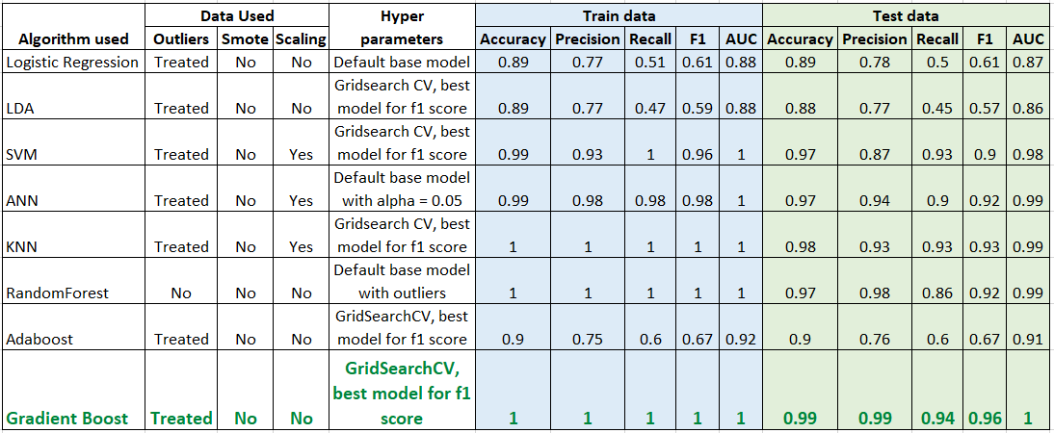
COMPARISON OF MODEL PERFORMANCE
Detailed model performance of Gradient boost is given in Appendix

Slide 9
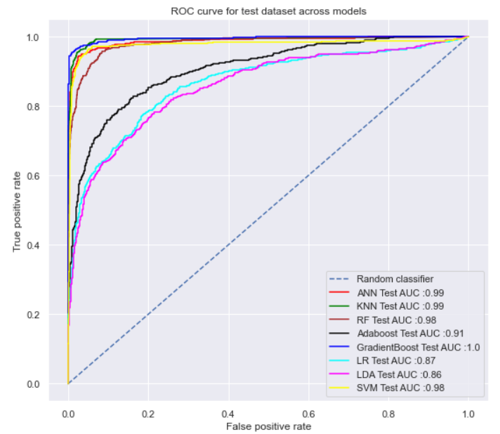
Good fit
Precision, F1 score & Accuracy
Interpretable
Best model
Gradient Boost is the best model! Why?
ROC curve and AUC
ROC : Performance of classification model at all classification thresholds
AUC: Signifies ability of model to differentiate between 0s and 1s
Why Gradient Boost?
Gradient Boost
Comparable train and test performances
Precision, Recall, F1-Score, Accuracy and AUC are highest
Gradient Boost Feature importances provided by Sklearn
Where
True positive rate/ Sensitivity/Recall = TP/ TP+FN = TP/ Actual total positives
False positive rate/1-Specificity = FP/FP+TN = FP/ Actual total negatives

Slide 10
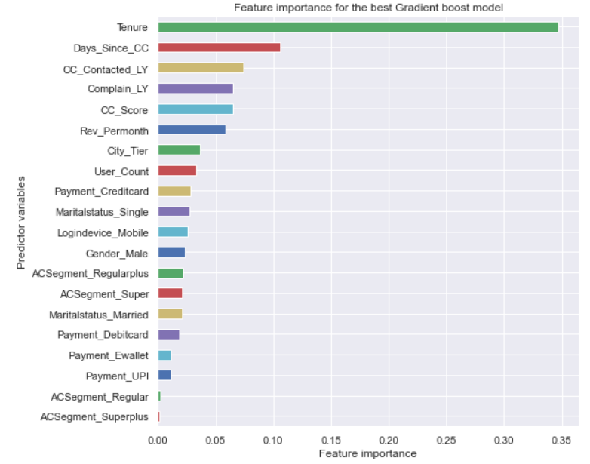
Top predictors for the best model
Tenure has the highest influence on the model – contributes 35% of all attributes feature importance. Low tenure (<2) has the highest churn
The next 4 features together contributes to 31% of importance
Days since customer care contact - 11%
Number of times customer care was contacted last year –7%
Whether a complaint was made last year or not – 7%
Customer care agent score – 6%
These are all related to customer care and service. Points to scope for improvement
Revenue per month attribute contributes to 6% of all feature importance. The churn in high revenue customers is more than in low revenue customers.
City tier and other features all have individual contributions of less than 5% each

Slide 11
Key Business Insights & Recommendations
3
Click here for
- Detailed Recommendations
- Other Insights
From Model interpretation and EDA

Slide 12
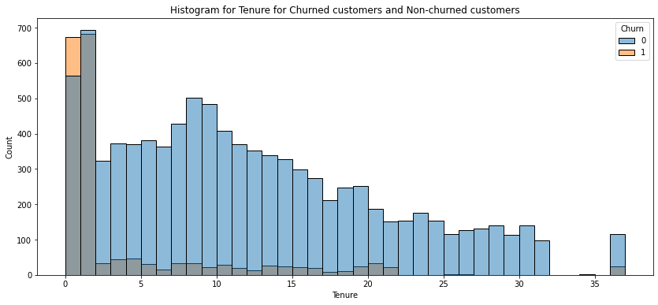
High churn rate in low tenure customers
Insight: Churn is highest between the tenure period 0 to 2
Recommendation: There needs to be more focus initially as soon as customers are onboarded, to ensure they do not leave
Activation/Onboarding team could extend support beyond the initial setup until customers settle down with the service
Customer care to initiate feedback survey to ensure customers have settled into the service

Slide 13
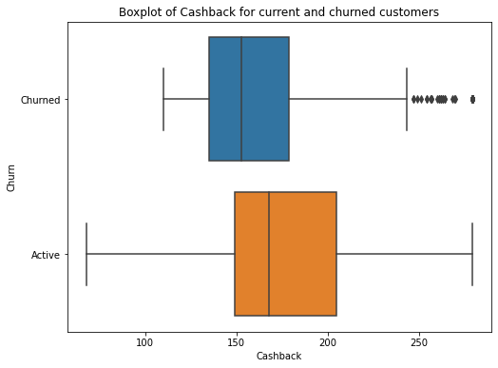
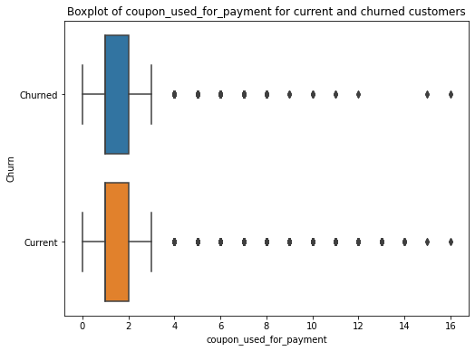
Cashback & Coupons
The churned customers as shown in first boxplot have lesser cashback
The churned and active customers have almost used the same number of coupons for payment
Insight : The current retention programs do not seem to be focusing on the customers with higher risk of churn
Recommendation: Review whether existing cashback and coupon programs are still relevant given the current churn model
If they are not relevant, design new retention programs to address current high risk customer group

Slide 14
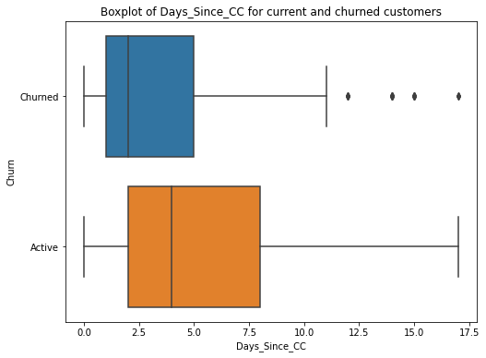
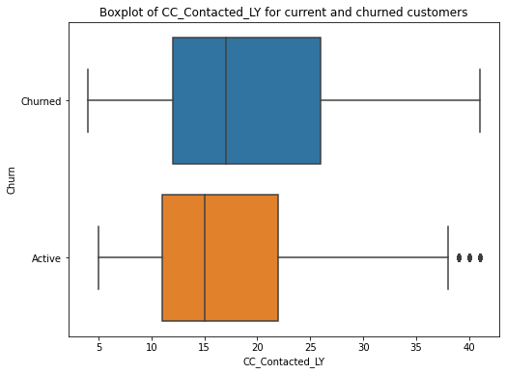
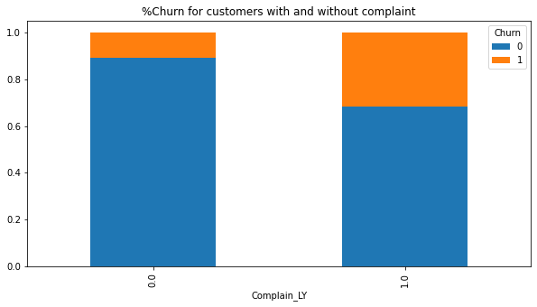
Churn and Customer care service
Churned customers seem to have contacted customer care more recently before churning
The number of times churned customers contacted customer care in the year is higher than number of times active customers contacted customer care
31% of customers who registered complaint churned Vs 11% of customers who have not registered complaint in last year
Insight: These indicate behavioral changes in customer before churn happens
Recommendation: Analyze Complaints & Customer care contact reasons
Perform Root cause analysis, identify and fix top reasons
Establish Service level agreements (if not already present)

Slide 15
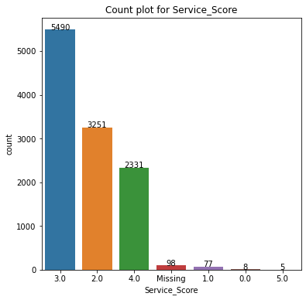
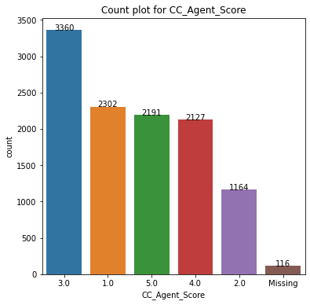
Customer care & Service – Customer perspective
Insight: 78% of customers have rated service as 3 or less than 3
Insight: 61% of customers have rated customer care agents a score of 3 or less than 3
Recommendation: Analyze customer feedback
Perform Sentiment analysis of the feedback (if any) that went along with scores
Identify top reasons that have resulted in low scores; if subjective feedback not captured, capture that as well

Slide 16
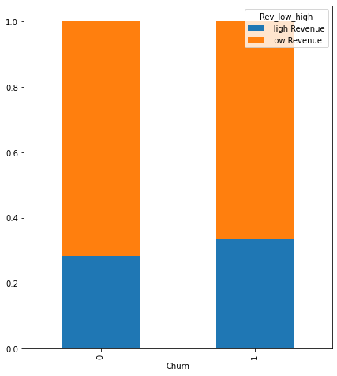
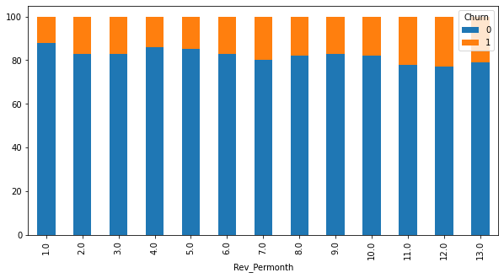
Revenue per month
Stacked bar chart showing
percent break up of high and low revenue by customer status
Stacked bar chart showing
percent break up of active and churned customers by revenue
Revenue > = 7 : High revenue
Revenue < 7 : Low revenue
The % churn of customers in higher revenue group, for revenue >=7 per month is higher than low revenue group customers
Insight: More proportion of high revenue customers are leaving compared to less revenue customers
Recommendation: Create segmented offers for high revenue customers

Slide 17
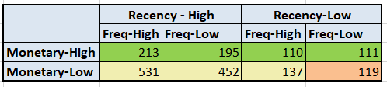

SEGMENTATION ILLUSTRATION
Segmentation basis
Recency (how recently they onboarded): High Recency - Tenure <=2
Frequency (how frequently they have contacted customer care): High Frequency - CC_contacted last year >=17
Monetary (Revenue): High Monetary – Revenue per month >=7
This is just an illustration. The above variables and their thresholds can be changed based on what features business places most emphasis on.
Illustration
High monetary
Segment 1:
Cashback /Coupon programs
Additional free channels
Periodic Customer feedback Survey
Low monetary-High Recency/Frequency Segment 2:
Additional free channels
Activation team support
for two months
Issues to be fixed within SLAs
Low monetary-Low Recency & Low Frequency Segment 3:
Proactive feedback survey within 2 months
Issues to be fixed within SLAs

Slide 18
THANKS!

Slide 19
Data Insights
Appendix
EDA plots

Slide 20
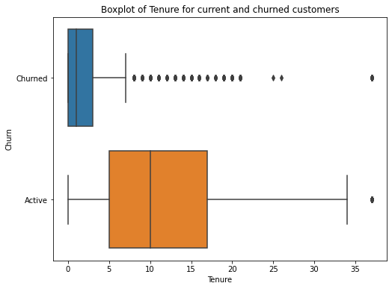
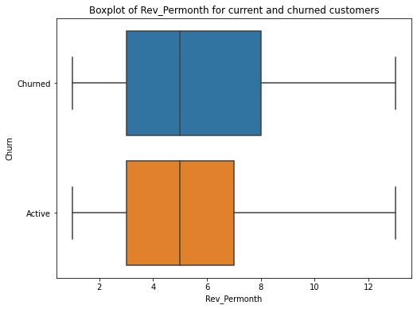
EDA – CONTINUOUS ATTRIBUTES
Tenure
The tenure of customers who have churned is much lesser than tenure of customers who are active
# Times Customer Care contacted last year
Churned customers have contacted customer care more times than Active customers
Revenue per month
75th percentile of monthly revenues is higher in churned customers compared to active customers
Days since customer care contacted
Customer churn seems to happen within few days of customer care contact (75 percentile – 5 days)

Slide 21
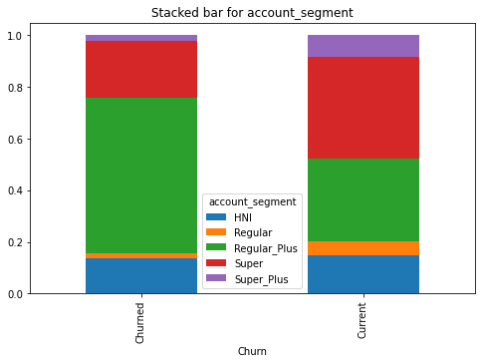
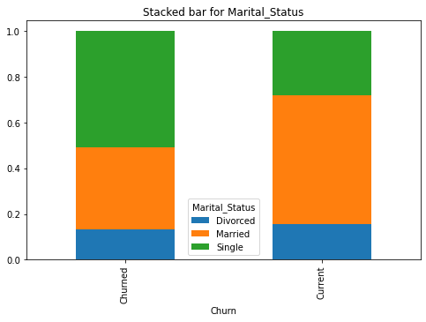
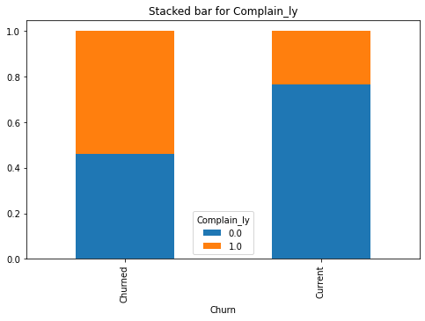
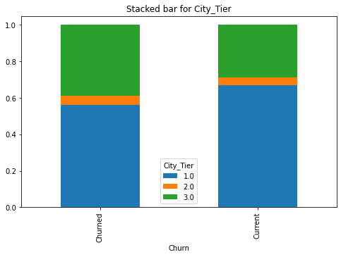
EDA – CATEGORICAL ATTRIBUTES
Account Segment
Compared to active customers, more Regular plus customers have churned
Marital Status
More single people show a propensity to churn compared to other status
Complaint last year?
More churned customers have registered complaints than active customers
City Tier
The proportion of Tier-3 customers in Churn is more than Active customers
Back

Slide 22
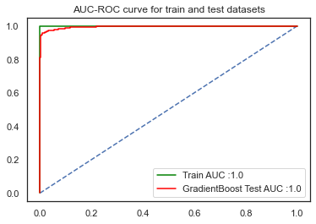
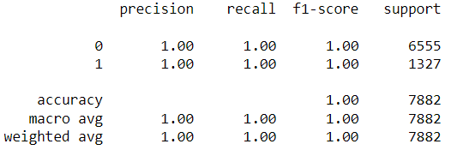
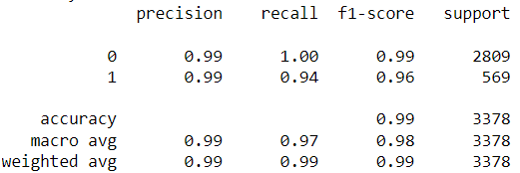
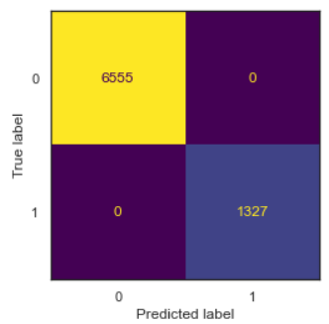
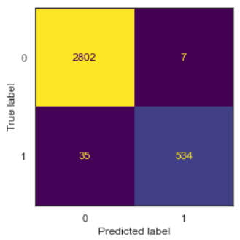
Model performance – Gradient Boost
Train data
Test data
Classification report
Classification report
Confusion matrix
Confusion matrix
5 - fold CV F1-score : 96.23
10-fold CV F1-score : 97.65
Test data F1-score : 96
Test data performance
Precision = TP/TP+FP = 0.99
(True positives/ Predicted positives)
Recall = TP/TP+FN = 0.94
(True positives/ Total actual positives)
Back

Slide 23
DETAILED RECOMMENDATIONS
From EDA and Model

Slide 24
ONBOARDING/ACTIVATION PROCESS
Both EDA and Model have shown Tenure to have the highest impact on Churn
Possible Reasons: Bad first experience or Trial periods/prepaid accounts that expire automatically if no top-up is done within a predefined period.
Important to determine between the above two reasons. Based on high customer care calls, complaints registered and low cashback and coupons for low tenure customers, it points to the first reason
Activation/Onboarding team could extend support beyond the initial setup until customers settle down with the service
Activation team proactively engages customers for the first month or two
Customer care take a feedback survey about the process so that any hiccups can be understood and sorted out
To increase response rates for feedback, gift cards/coupons can be given

Slide 25
COMPLAINT ANALYTICS AND MANAGEMENT
Complaint registered customers churned 182% times more than customers without complaint
Possible Reasons: Complaint not resolved on time or to customer’s satisfaction.
Analyze complaints from customers and identify top reasons
Focus on root cause contributing to top reasons customers complain and address the root causes
Establish Service level agreements to track and close complaints
Ensure proactive engagement through status updates with customers until complaint is open
Take customer feedback after complaint has been closed

Slide 26
REVIEW CUSTOMER CARE AND SERVICE PROCESS
78% of customers have rated service as 3 or less than 3 (out of a scale of 5)
61% of customers have rated customer care agents a score of 3 or less than 3 (out of 5)
Possible Reasons:
Service score could be reflective of issues ranging from technical or plan structure or support from activation and customer care teams
Customer care agent score may be reflective of agent behavior (e.g., knowledge, disposition) or process (e.g., call wait time)
It is recommended to do a root cause analysis (pareto) of the feedback (if any) that went along with scores.
Focus on root causes for top reasons for low feedback scores. There may be pointers to reasons for churn as well
If verbal feedback not captured currently, it is suggested to change the process to capture that

Slide 27
REVIEW CURRENT RETENTION SPENDS
The median cashback is 10% more for active customers than churned customers
Same number of coupons have been used by churned and active customers
Possible Reasons: Existing retention programs may not specifically be targeting customers at risk for churn (or)
Existing programs may have addressed earlier high risk churn segment thereby reducing churn in
that segment and hence current risk profile has changed
Review whether existing cashback and coupon programs are still relevant given the current churn model
If they are not relevant, design new retention programs to address current high risk customer group
Back

Slide 28
CREDITS
Special thanks to people who offered these resources for free:
Presentation template by SlidesCarnival
Photographs by Startup Stock Photos
REFERENCES
Essentials of customer churn and retention | Smartlook Blog
Strategies for Reducing Churn Rate in the Telecom Industry (omnisci.com)
DTH industry: A glimpse of profits at last! | Business Standard News (business-standard.com)
Forbes India - Direct To My Pocket: The DTH Tug Of War
Customer Retention Marketing vs. Customer Acquisition Marketing | OutboundEngine

